Slide 1

Predicting Youth Drug Use
Using NSDUH data to understand and predict youth behavior
Ankit Bisleri

Slide 2
Dataset Overview, Cleaning and Features
National Survey on Drug Use and Health (NSDUH) Youth Survey
Dataset Overview
Data source: National Survey on Drug Use and Health (NSDUH)
Focus: Youth respondents aged 12–17 in the United States
Scope: 10,000+ responses including substance use patterns, demographics, and behavioral characteristics
Objective: Predict and analyze marijuana use based on personal, social, and environmental factors
Dataset Cleaning
Special codes (e.g., 991 = Never used, 993 = Did not use in past year) were treated as missing
Replaced with NaN and dropped for modeling purposes
Removed rows with missing values in key predictors or outcomes
Recoded outcome variables like MRJFLAG and MRJYDAYS into interpretable labels for modeling
Targets:
Binary: Ever used marijuana (MRJFLAG)
Multi-class: Frequency of marijuana use in past year (6 bins)
Regression: Age of first use (IRMJAGE)
Features grouped into three categories:
Demographic: Gender, Race/Ethnicity, Family Income Level, Poverty Status, Population Density, Metro/Non-Metro County, Self-Reported Health
School-related: Currently in School, Grade Level, School Absence (Sick Days)
Parental environment: Mother in Household, Father in Household, Parent Checks Homework, Parent Helps with Homework, Parent Assigns Chores, Parent Limits TV Time etc

Slide 3
Research Questions
Binary Classification: Has the youth ever used marijuana?
Multi Class: How frequently does the youth use marijuana in a year?
Regression: At what age did the youth first use a substance?

Slide 4
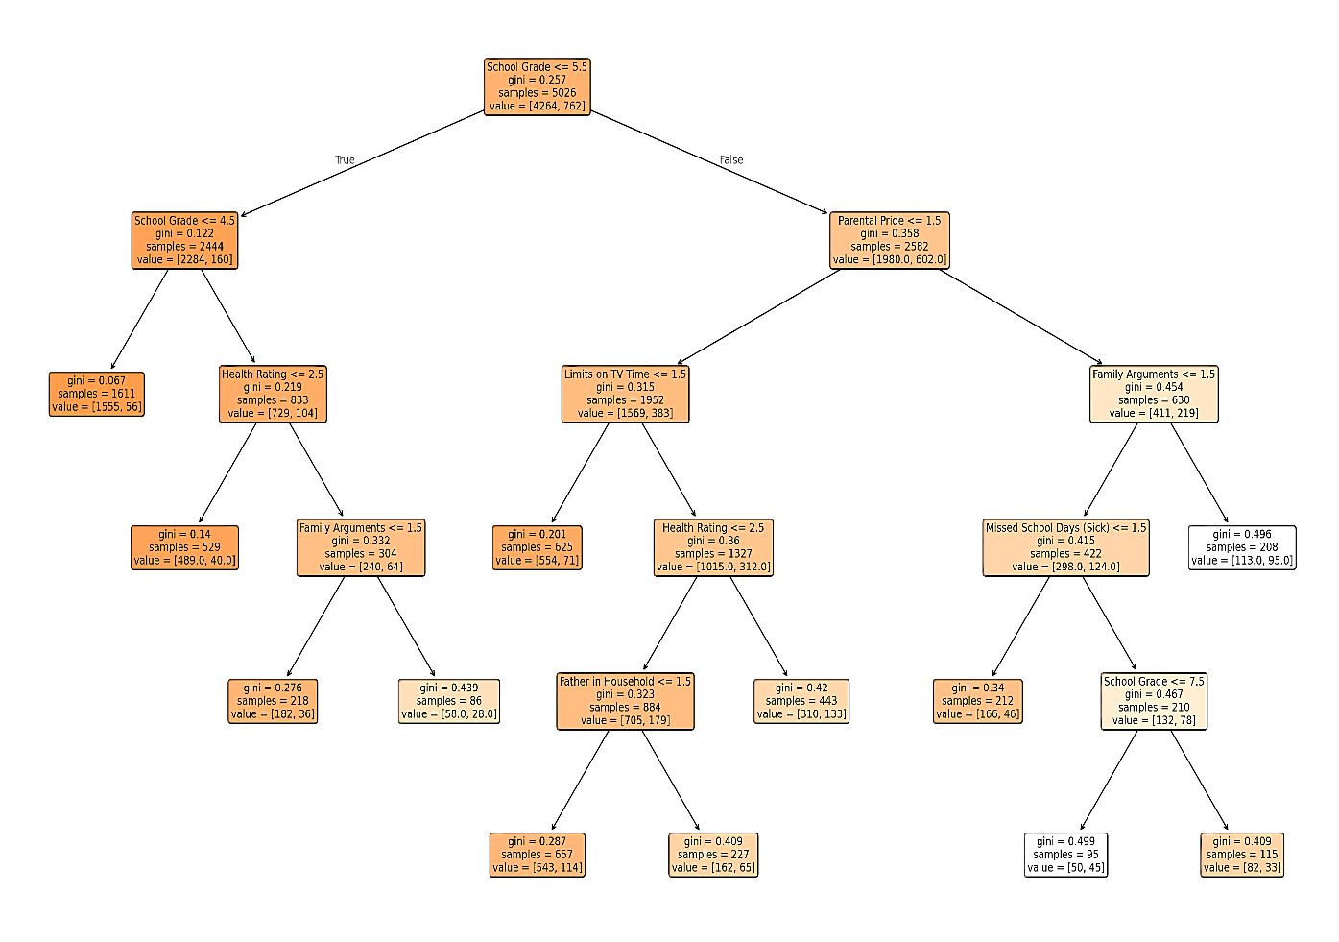
Has the youth ever used marijuana?
Model: Decision Tree
Decision Tree with Demographic, School, and Parental Features achieved 99% accuracy.
Top 5 essential features:
1. School Grade
2. Missed School Days(Sick)
3. Race/Ethnicity
4. Family Income
5. Health Rating

Slide 5
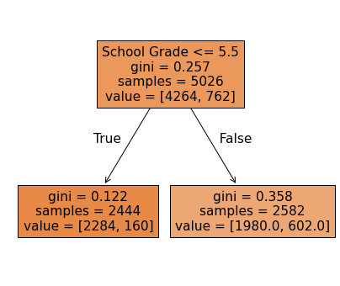
Has the youth ever used marijuana?
Model: Decision Tree
After Pruning:
Best Tree Size: 2 leaf nodes
Accuracy dropped to 84.34%
Number of predictors reduced to 2
.
Conclusion: The number of predictors reduced to 2 but even the accuracy reduced from 97.65% to 84.34%.
Increasing leaf nodes up to 12 did not improve accuracy

Slide 6
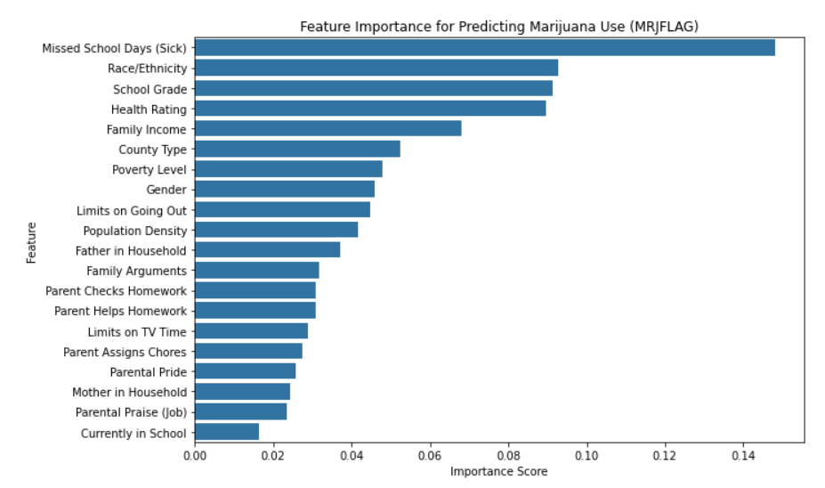

Has the youth ever used marijuana?
Model: Random Forest
Trained Random Forest with the same features as the decision tree
Achieved 84% accuracy
Top 3 important features (according to importance graph):
Missed School Days (Sick)
Race/Ethnicity
School Grade
Different from decision tree's top features
Feature importance by group:
Demographic features play the most significant role in predicting marijuana use Followed by Parental factors and then School-related features.

Slide 7
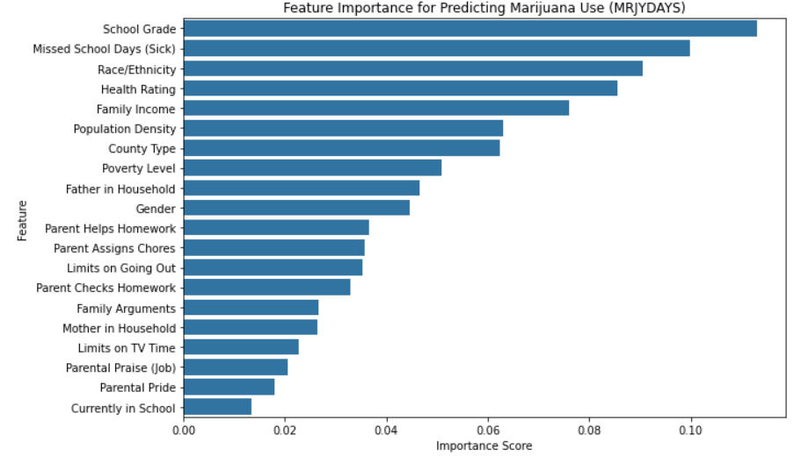
How frequently do users consume marijuana over a year?
Model: Decision Tree
Trained Random Forest with the same features as the decision tree
Achieved 75.89% accuracy
After pruning:
Best tree size: 14 leaf nodes
Accuracy improved to 86.87%
Approx. 10% improvement over the decision tree’s accuracy
Top 3 important features (according to importance graph):
Missed School Days(Sick)
School Grade
Health Rating

Slide 8
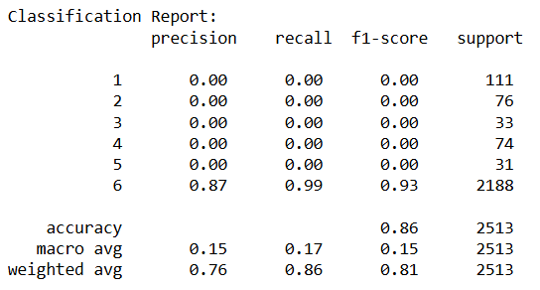
How frequently do users consume marijuana over a year?
Model: Decision Tree
Classification report shows severe class imbalance
Class 6 (non-users) has 93% accuracy
All other classes have 0% accuracy
Used SMOTE (Synthetic Minority Over-sampling Technique) to address imbalance
SMOTE generates synthetic samples for minority classes to improve model

Slide 9
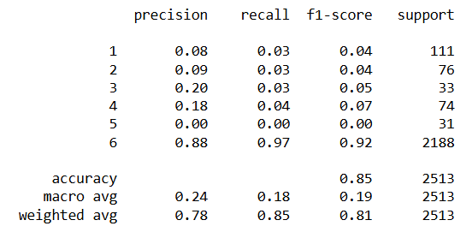
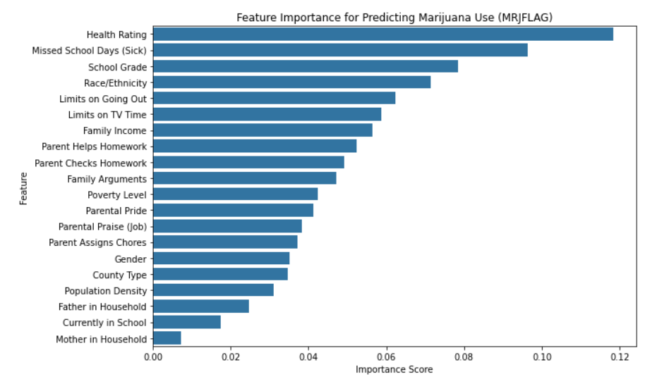
How frequently do users consume marijuana over a year?
Model: Random Forest
As we can see from the classification report we have a balanced dataset and has a accuracy of 85%.
Top 3 important features (according to importance graph):
Health Rating
Missed School Days (Sick)
School Grade

Slide 10
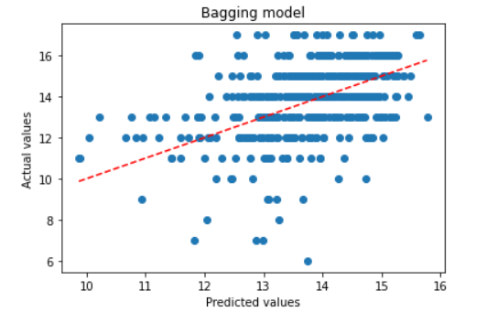
Can we predict the age of first marijuana use?
Model: Random Forest Regressor
The bagging model has 100 trees with 25 features split at each split and has MSE 2.66
Points are somewhat clustered around the trend line → decent but not perfect fit
Model struggles with exact predictions due to binned/rounded nature of age data
Underestimation for some older actual ages

Slide 11
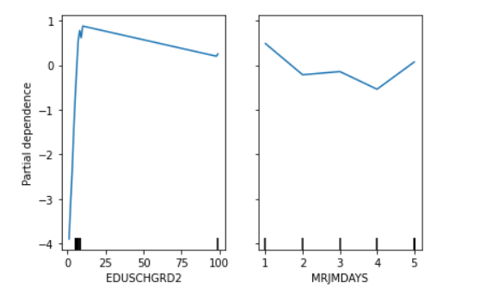
Can we predict the age of first marijuana use?
Model: Gradient Boost Regressor
Grade Level and Marijuana Use Days in Past Month are the top 2 important factors
Grade level:
Steep jump in partial dependence at lower grade levels (likely elementary to high school).
Indicates that lower grades are associated with higher predicted marijuana use.
Marijuana Use Days in Past Month
Partial dependence value suggests minimal marginal impact beyond intial usage.
This has MSE of 3.67

Slide 12
Ethical Considerations

Slide 13
Conclusions
Decision Tree and Random Forest models consistently highlighted a few features as especially important:
School Grades – Strongest overall predictor of use
Parental Support (e.g., pride, help with homework) – Reduces likelihood of use
Family Conflict – More arguments linked with higher use
Health & Absences – Poor health and skipping school increased risk
Father Presence & Household Rules – Provided some protective effect
Models
Binary Trees captured decision paths linking low grades & poor support to use
Multiclass Models helped differentiate usage intensity
Regression Models predicted age or frequency of use with moderate accuracy
Partial Dependence Plots confirmed feature effects across models

